Slide 1
Key Vault
….but why?

Slide 2
Why?
How many people have passwords to secure production resources?
How many config files contains connection strings?
How easy would it be to change a shared resource password in production?

Slide 3
Key Vault
Secure storage of
Secrets
Keys
Certificates

Slide 4
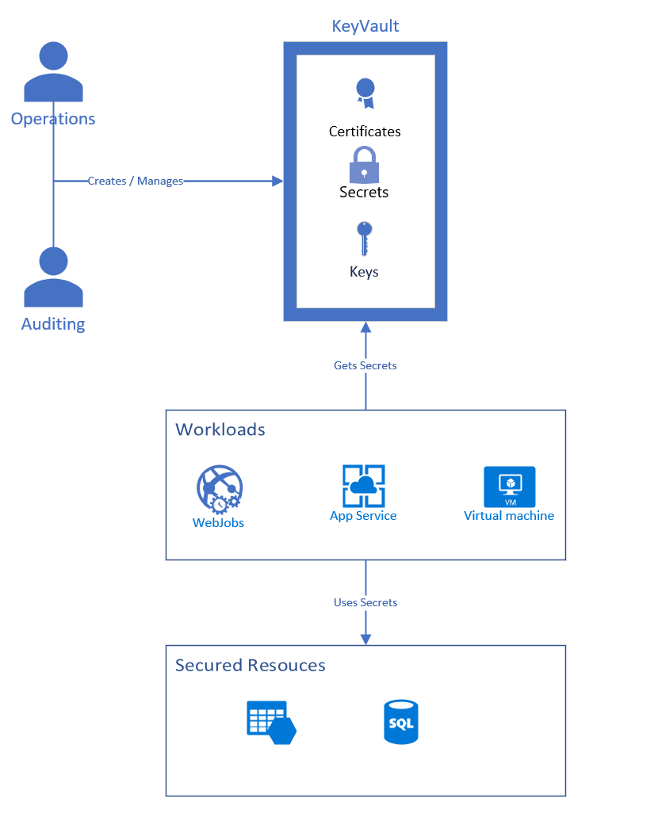
The bigger picture

Slide 5
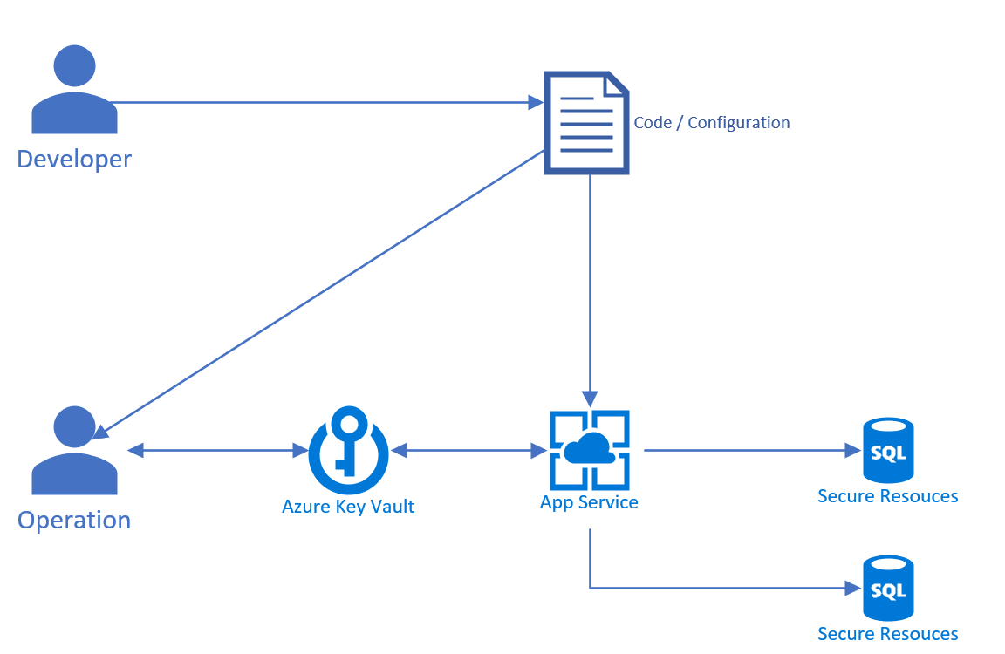
Life cycle of a secret

Slide 6
Conclusion

